Slide 1
Introduction
Statistics
Simple forecasts
Residuals
Forecasting and Time Series Analysis
Rockhurst Universithy
Week 1
*Created by Dr. San Cannon

Slide 2
Introduction
Statistics
Simple forecasts
Residuals
Introduction and setting expectations
Background: I expect you to be comfortable with:
Programming in R. We will use R markdown files in R Studio in class but you are welcome to use whatever flavor you like. Jupyter notebooks running the R kernel are also acceptable. Expertise with R time series formats is not required - we’ll develop that during the course.
Basic statistics. We will go over a bit tonight but thats all Asking questions.
Class format: We will spend the first half of class walking through slides to cover the concepts and the second half walking through code to cover the applications.

Slide 3
Introduction
Statistics
Simple forecasts
Residuals
Forecasting vs prediction
What’s the difference between a forecast and a prediction? Nate Silver’s definition:
The terms prediction and forecast are employed differently in
different fields; in some cases, they are interchangeable, but other disciplines differentiate them. No field is more sensitive to the distinction than seismology. If youre speaking with a seismologist:
A prediction is a definitive and specific statement about when and where an earthquake will strike: a major earthquake will hit Kyoto, Japan, on June 28. Whereas a forecast is a probabilistic statement, usually over a longer time scale: there is a 60 percent chance of an earthquake in Southern California over the next thirty years.
The USGSs official position is that earthquakes cannot be predicted. They can, however, be forecasted.
Most economists would say the same thing about a recession.

Slide 4
Introduction
Statistics
Simple forecasts
Residuals
More FvP
Another way to think about it:
A forecast is a probabilistic judgment over a long period while prediction is a definitive and specific statement about an event occurring. ¹
My perspective: Predictive analytics looks to predict trends and patterns. It can involve predicting which types of customers might buy your product, leave your company, or default on a loan - all of which generally happen in the future but don’t necessarily involve a measure of time. Forecasting explicitly addresses what we can and can’t say about trends and patterns over a particular period in the future.²
¹From http://blog.perchingtree.com/what-is-hyperforecasting/
²AKA: if you can chart it without time on the X axis, it’s not forecasting.

Slide 5
Introduction
Statistics
Simple forecasts
Residuals
Introduction to time series
Definition: A statistical time series is dened as a collection of random variables {X₁, X₂, X₃, } indexed according to the order they are obtained in time.
Time series data {X_{t}} e.g. employment rates, Apple stock returns, daily temperatures, are instances or occurrences of a stochastic process that changes at each time t

Slide 6
Introduction
Statistics
Simple forecasts
Residuals
Some notation
t = 1, 2, 3,... An index denoting the time period of interest. t = 1 is the first period in a series.
y₁, y₂, y₃, ..., y_{n} A series of n values measured over n time periods, where yt denotes the value of the series at time period t. For example, for a series of daily average temperatures, t = 1, 2, 3,... denotes day 1, day 2, and day 3; y₁, y₂, and y₃ denote the temperatures on days 1,2, and 3.
f_{t} ft+k
The forecasted value for time period t.
f_{t+k} The k-step-ahead forecast when the forecasting time is t. If we are currently at time period t, the forecast for the next time period (t + 1) is denoted f_{t+1}.

Slide 7
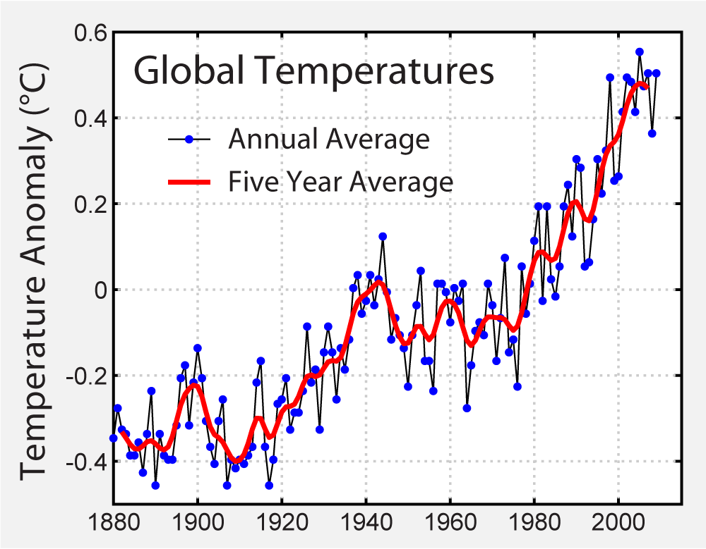
Introduction
Statistics
Simple forecasts
Residuals
Examples of Time Series
Source: https://commons.wikimedia.org/wiki/File:Instrumental_Temperature_Record.png

Slide 8
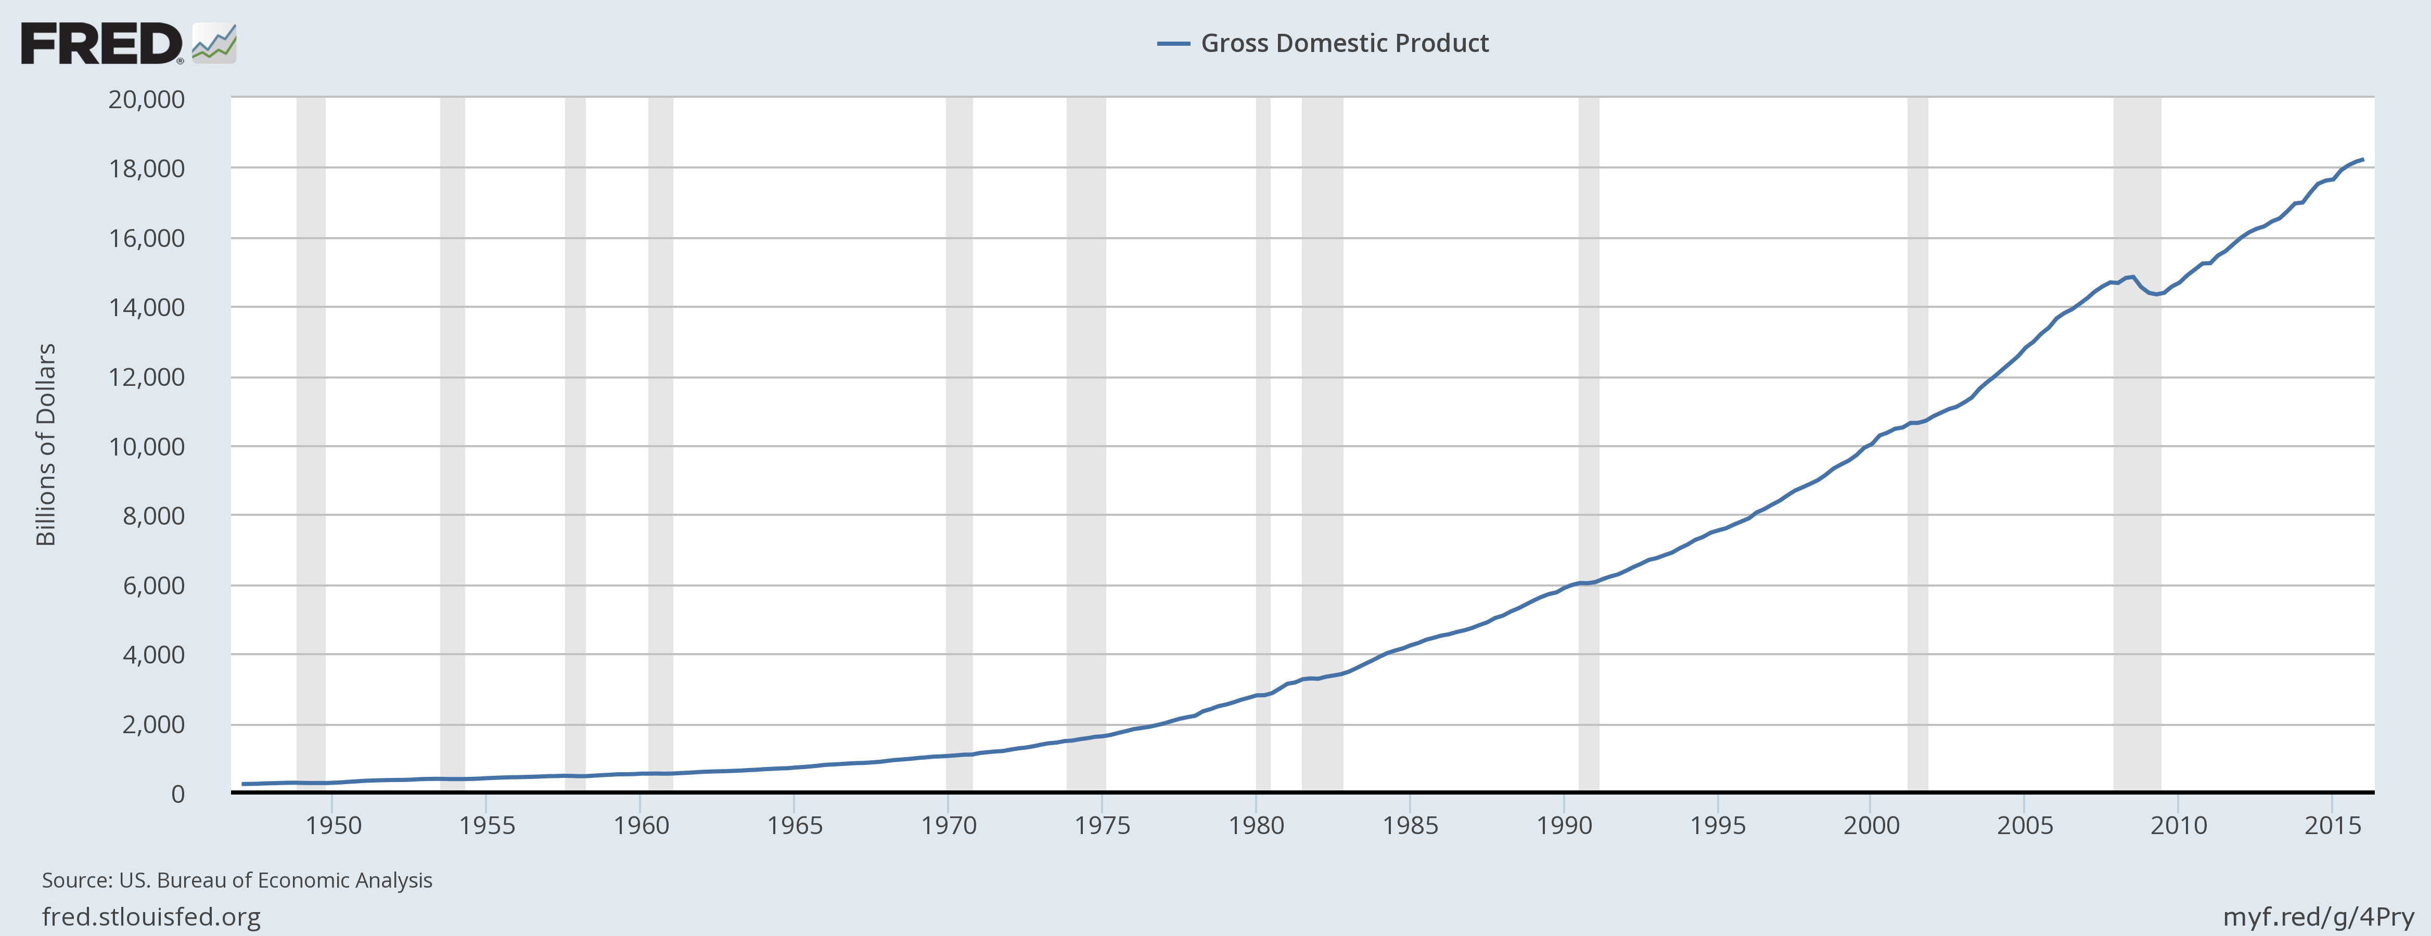
Introduction
Statistics
Simple forecasts
Residuals
Examples of Time Series
Source:US. Bureau of Economic Analysis, Gross Domestic Product [GDP], retrieved from FRED, Federal Reserve Bank of St. Louis; https://fred.stlouisfed.org/series/GDP, July 1, 2016.

Slide 9
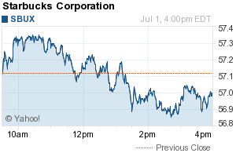
Introduction
Statistics
Simple forecasts
Residuals
Examples of Time Series
Source: Yahoo Finance, retrieved July 1, 2016

Slide 10
Introduction
Statistics
Simple forecasts
Residuals
Many domains
Agriculture
annual crop production
crop prices
Business/Economics
daily stock price
weekly interest rates
monthly price indexes
quarterly output
annual earnings
Engineering
sound
electric signals
voltage
Medical Studies
EEG
EKG
Meteorology
hourly wind speed
daily temperature
monthly price indexes
annual rainfall
Social Sciences
annual birth rates
mortality rates
accident rates
crime rates

Slide 11
Introduction
Statistics
Simple forecasts
Residuals
Why are time series special?
Basic tenet of most statistical tests begins with words like:
Suppose that X = (X₁, X₂, ) is a sequence of independent, identically distributed, real-valued random variables with mean µ and variance σ²
Fundamental characteristic of time-series: in general, samples are correlated (thus statistically dependent).
Time series violate the iid assumption.
We cannot ignore that when doing statistical tests.
Therefore, we need to learn how to estimate, model and analyze this dependency/correlation.
Notes:
Independent: all items (X1, X2, etc.) are independent events; they are not connected in any way to each other.
Identically distributed: all items come from the same probability distribution (there’s no trend)

Slide 12
Introduction
Statistics
Simple forecasts
Residuals
Statistics refresher
Vocabulary: Population
a full set of realized outcomes (i.e., data) generated by an underlying probabilistic process.
a subset of realized outcomes (i.e., data) generated by an underlying probabilistic process.
summary of information about various events within a sample
summary of information about various events within a population
Sample
Statistic
Parameter

Slide 13
Introduction
Statistics
Simple forecasts
Residuals
Descriptive statistics
First moment: mean or expected value of X, µ(X ) - the center of distribution
Second moment: variance of X, σ₂(X ) - the spread of distribution
Third moment : skewness, S(X) - the symmetry of distribution
Fourth moment: kurtosis, K(X) - the sharpness of the peak of the distribution

Slide 14
Introduction
Statistics
Simple forecasts
Residuals
Sample statistics
Remember, we rarely observe the moments of the population. We generally only have a sample from the population.
Sample mean: X = ^{1 ),N} (x_{i} )
N i =1
),_{N}
Sample variance: s² =
1
N−1 i =1
(x_{i} − x )²
_{N}
3
Sample skewness : S_{x} =
1
_{i =1} (x_{i} −x )
N−1
_{s}3
_{N}
4
Sample kertosis : K_{x} =
1
_{i =1} (x_{i} −x )
_{s}4
N−1

Slide 15
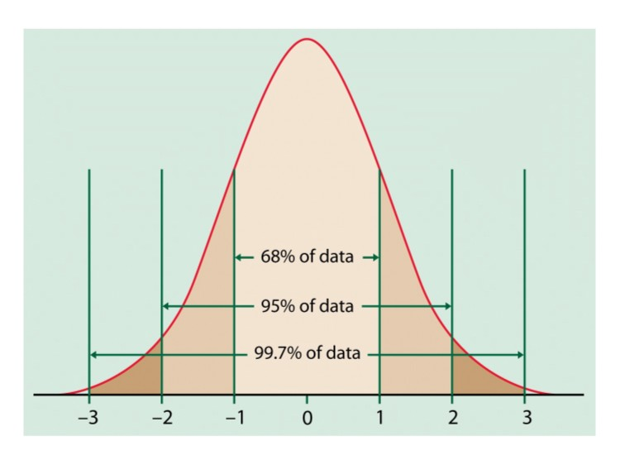
Introduction
Statistics
Simple forecasts
Residuals
Normal distribution N(0,1)
The normal distribution is a special distribution that is completely specified by its mean and variance.
Skewness of a normal variable X is S_{X} = 0 Kurtosis of a normal variable X is K_{X} = 3

Slide 19
Introduction
Statistics
Simple forecasts
Residuals
Simple forecasting models
You don’t need a fancy forecasting model
Average method: Forecast of all future values is equal to mean of historical data {y₁, . . . , y_{T} }.
Forecasts: f_{T +h|T} = y = (y₁ + . . . + y_{T} )/T
Na¨ıve method: Forecasts equal to last observed value. Forecasts: f_{T +h|T} = y_{T} .
Seasonal na¨ıve method: Forecasts equal to last value from same season.
Forecasts: f_{T +h|T} = y_{T +hkm}
where m = seasonal period and k = [(h − 1)/m] + 1

Slide 20
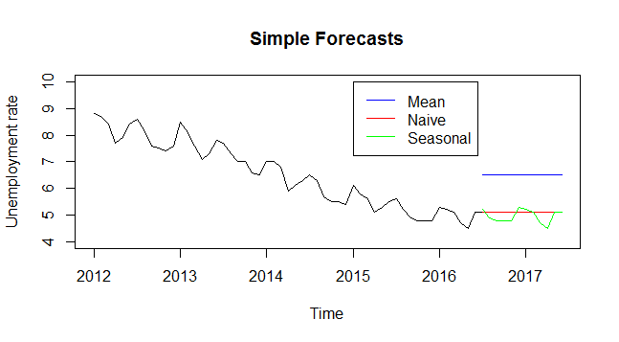
Introduction
Statistics
Simple forecasts
Residuals
Simple forecasting models

Slide 21
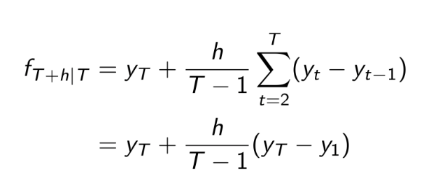
Introduction
Statistics
Simple forecasts
Residuals
Drift model
Forecasts equal to last value plus average change. Forecasts:
Equivalent to extrapolating a line drawn between first and last observations.

Slide 22
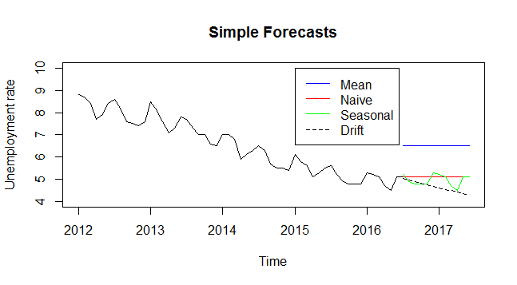
Introduction
Statistics
Simple forecasts
Residuals
Simple forecasting models

Slide 23
Introduction
Statistics
Simple forecasts
Residuals
Forecast residuals
Residuals in forecasting: difference between observed value and its forecast based on all previous observations: e_{t} = y_{t} − f_{t|t−1}
Assumptions
1 e_{t} uncorrelated. If they aren’t, then information left in residuals that should be used in computing forecasts.
2 e_{t} have mean zero. If they don’t, then forecasts are biased.
Useful properties (for prediction intervals)
1 e_{t} have constant variance.
2 e_{t} are normally distributed.

Slide 24
Introduction
Statistics
Simple forecasts
Residuals
Measures of forecast accuracy
Two most commonly used measures are scale dependent:
Mean absolute error: MAE= ^{1 ),T} |y_{t} − f_{t} |
T i =1
I
Root mean squared error: RMSE =
₁ ),_{T}
(y_{t} − f_{t} )²
T i =1
Some are ratio’s of other scale dependent measures:
Theils U Statistic :
RMSE of forecast
RMSE of naive forecast
The closer Theil’s U is to 0, the better the model. Values of 0.55 or less are very good.
Others are not:
Mean absolute percentage error: MAPE= 100 ^{1 ),T} |y_{t} − f_{t} |/|y_{t}|
T i =1
Only sensible if y_{t} >> 0 for all t, and y has a natural zero

Slide 25
Introduction
Statistics
Simple forecasts
Residuals
Summary
Tonight we covered:
Forecast versus prediction Why time series are special Brief reminder about statistics Simple forecasting options
Introduction to forecast residuals Measures of forecast accuracy
Next: how to actually use some of this in R

